Slide 1

Evaluation activities on
Chinese Evaluation Group (ChEG)
IMT-2020 (5G) Promotion Group
December, 2019

Slide 2
Contents
Background
ChEG Evaluation activities
Evaluation intention
Calibration works
Summary of ChEG final results
Conclusion

Slide 3
ChEG background
The Chinese Evaluation Group (ChEG) is built under the structure of IMT-2020(5G) Promotion Group. the Promotion Group works on 5G research & development, pre-standardization activities, spectrum issues, technical scheme evaluation, and technical trials.
The major task of ChEG includes: registration and participation in ITU independent evaluation activity for formal evaluation results on IMT-2020 submission.
During the period of IMT-Advanced and IMT-2000
ChEG has participated in developing IMT related systems since early stages, e.g. IMT-2000 evaluation in 1998, OFDMA TDD WMAN evaluation in 2007 and IMT-Advanced evaluation in 2010.

Slide 4










ChEG in the structure of IMT-2020 (5G) Promotion Group
Expert Committee
Secretariat
Application WG
Spectrum WG
ITU WG
/ChEG
Bearing Network Tech. WG
Network Tec.WG
5G trial WG
C-V2X WG
3GPP WG
Major participants of ChEG:

Slide 5
Activation on IMT-2020 evaluation
From the year 2017, ChEG joined meetings and workshops. Through these meetings, members of ChEG have opportunities to discuss and reach consensus on parameter assumption, calibration, evaluation methodologies and other issues which are related to evaluation tasks.
ITU-R WP5D
Workshop on IMT-2020 Terrestrial radio interfaces (Munich, 2017)
WP5D #28 ~ #33
Proponent: 3GPP
3GPP Workshop on 5G NR (Brussels, 2018)
Notes:
ChEG participated in several meeting and workshops from ITU-R and 3GPP with proponents and IEGs, to clarify technical details and exchange knowledge of evaluation.

Slide 6
ChEG evaluation intention (5D/1305)
IMT-2020 SUBMISSION
Registered Independent Evaluation Group | 3GPP |  | CHINA | KOREA | TSDSI | ETSI (TC DECT), DECT FORUM | Nufront
 | RIT | SRIT
 | IMT-2020/14 | IMT-2020/13 | IMT-2020/15 | IMT-2020/16 | IMT-2020/19 | IMT-2020/17 | IMT-2020/18
ChEG |  |  |  | 
Based on received candidate IMT-2020 proposals from ITU-R WP 5D, ChEG aims to evaluate 3GPP NR RIT, 3GPP SRIT, China and Korea submissions.

Slide 7
Calibration (5D/1269)
Test Environment | Evaluation Configuration | Channel model |  | Number of samples | 50% CDF on Difference between 3GPP and ChEG
 |  |  |  |  | Coupling Loss | DL geometry
Indoor Hotspot-eMBB | Config A (4GHz) | Channel model A | 12 TRxP | 6 | <0.09 dB | <0.04 dB
 |  |  | 36 TRxP | 6 | <0 dB | <0.06 dB
 |  | Channel model B | 12 TRxP | 6 | <0.15 dB | <0.21 dB
 |  |  | 36 TRxP | 7 | <0.09 dB | <0.02 dB
 | Config B (30GHz) | Channel model A/B | 12 TRxP | 6 | <0.04 dB | <0.11 dB
 |  |  | 36 TRxP | 6 | <0.05 dB | <0.26 dB
 | Config C (70GHz) | Channel model A/B | 12 TRxP | 6 | <0.17 dB | <0.19 dB
 |  |  | 36 TRxP | 5 | <0.13 dB | <0.02 dB
Dense Urban-eMBB | Config A (4GHz) | Channel model A |  | 7 | <0.53 dB | <0.01 dB
 |  | Channel model B |  | 7 | <0.19 dB | <0.15 dB
 | Config B (30GHz) | Channel model A/B |  | 7 | <0.17 dB | <0.57 dB
Rural-eMBB | Config A (1732m, 700MHz) | Channel model A |  | 7 | <0.2 dB | <0.13 dB
 |  | Channel model B |  | 7 | <0.28 dB | <0.04 dB
 | Config B (1732m, 4GHz) | Channel model A |  | 7 | <0.45 dB | <0.26 dB
 |  | Channel model B |  | 7 | <0.37 dB | <0.11 dB
 | Config C (LMLC, 6km, 700MHz) | Channel model A |  | 6 | <0.16 dB | <0.13 dB
 |  | Channel model B |  | 6 | <0.04 dB | <0.22 dB

Slide 8
Calibration
Test Environment | Evaluation Configuration | Channel model | Number of samples | 50% CDF on Difference between 3GPP and ChEG
 |  |  |  | Coupling Loss | DL geometry
Urban Macro-mMTC | Config A (500m, 700MHz) | Channel model A | 6 | <0.35 dB | <0.22 dB
 |  | Channel model B | 6 | <0.37 dB | <0.06 dB
 | Config B (1732m, 700MHz) | Channel model A | 6 | <0.39 dB | <0.29 dB
 |  | Channel model B | 6 | <0.11 dB | <0.11 dB
Urban Macro-URLLC | Config A (4GHz) | Channel model A | 6 | <0.12 dB | <0.18 dB
 |  | Channel model B | 6 | <0.22 dB | <0.14 dB
 | Config B (700MHz) | Channel model A | 6 | <0.45 dB | <0.16 dB
 |  | Channel model B | 6 | <0.1 dB | 0.2 dB
Calibration results are well aligned. The difference results of DL geometry (wideband SINR) between ChEG and 3GPP are typically within 0.01~0.29 dB of the average SINR; while the difference of Coupling Loss is less 0.53dB .

Slide 9
Summary of ChEG results
---Simulation assumption and features
Test environments in eMBB for NR and LTE
FDD only in FR1
TDD, picking some typical frame structure, such as DDDSU, DSUUD, DDDSUDSUUD and DDDDDDDSUU.
Sub carrier spacing: 15/30kHz in FR1, 60/120kHz in FR2
Urban macro URLLC: for NR
NR UL & DL
Urban macro mMTC for NR and LTE
Evaluated NB-IoT(Non-full buffer and full buffer) and NR (full buffer)

Slide 10
Summary of ChEG results
In all five test environments in three usage scenarios, the evaluation results show that 3GPP technologies meet the IMT-2020 requirements (M.2410)
All of simulation configurations and parameters are alliance with 3GPP’s self-evaluation
3GPP Rel-15 are enough to meet requirements in all test environments below 6GHz, while results of some test environments obtained improvement from 3GPP Rel-16.
ChEG selects different antenna deployment configuration with varying frame structures
Our results are close to those self-evaluation results on 3GPP technology, and meet ITU-R requirements*
(*All evaluation details can be found in “ChEG final evaluation report”)

Slide 11


ChEG evaluation progress
2017
2018
2019
2020
Current
RAN
#75
RAN
#76
RAN
#77
RAN
#78
RAN
#79
RAN
#80
RAN
#81
RAN
#82
RAN
#83
RAN
#84
RAN
#85
RAN
#86
RAN
#87
RAN
#88
RAN
#89
RAN
#90
Description template
1st Submission
Final Submission
WRC-19
5D
#26
5D
#27
5D
#28
5D
#29
5D
#30
5D
#31
5D
#31bis
5D
#32
5D
#33
5D
#34
5D
#35
5D
#36
5D
#36bis
Proposals IMT-2020
Evaluation
Initial Consideration
Platform calibration
ChEG report submission

Slide 12
Conclusion
ChEG evaluated 3GPP technologies, including 3GPP submission 1, 3GPP submission 2, Korea submission and China submission.
ChEG evaluation report shows that
3GPP NR RIT submission can meet ITU-R requirements.
3GPP SRIT submission can meet ITU-R requirements.
Korea and China submission also meet ITU-R requirements.
ChEG evaluation report submitted in WP5D #33 is a complete report.
ChEG is welcome to cooperate with 5D, proponents and other IEGs.

Slide 13
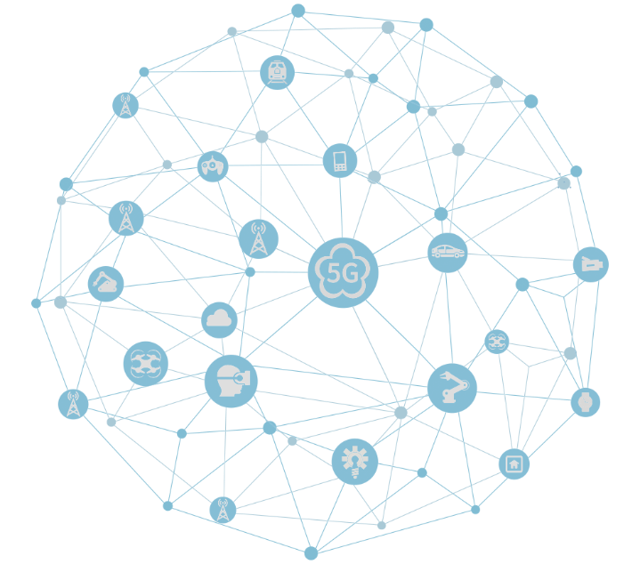
感谢
Thanks
Merci
Спасибо
شكرا لك
Gracias

Slide 14
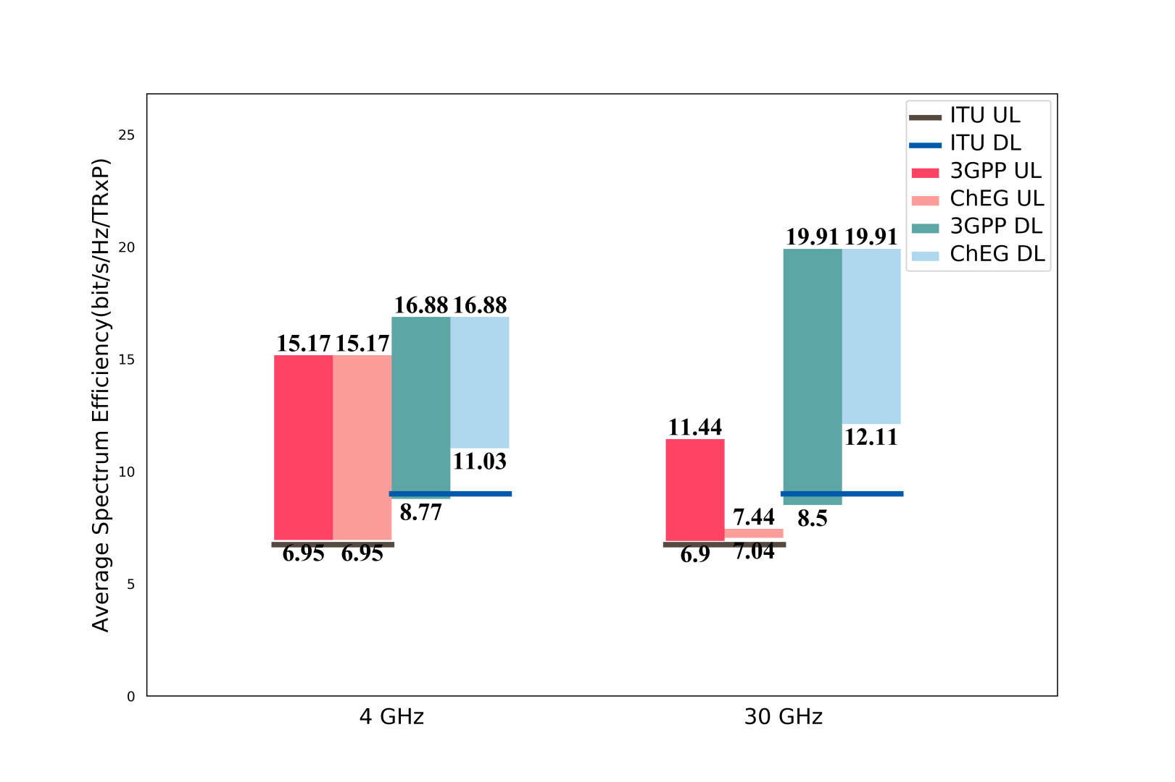
Preliminary results on Indoor hotspot-eMBB

Slide 15
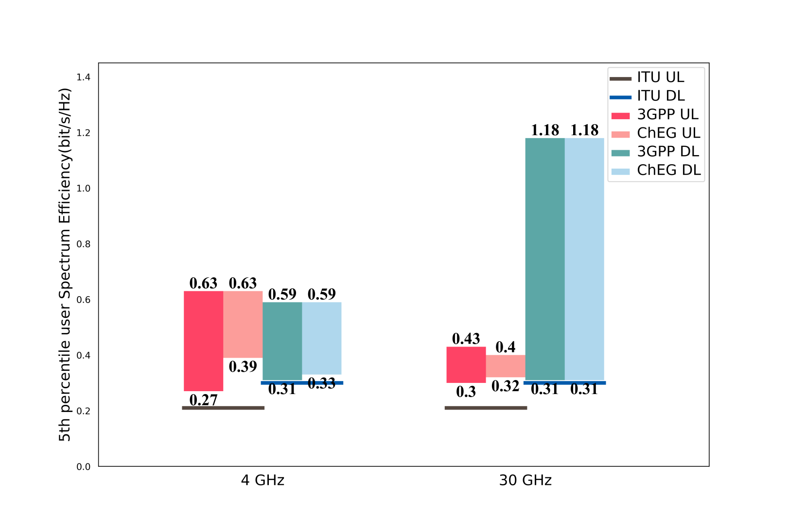
Preliminary results on Indoor hotspot-eMBB

Slide 16
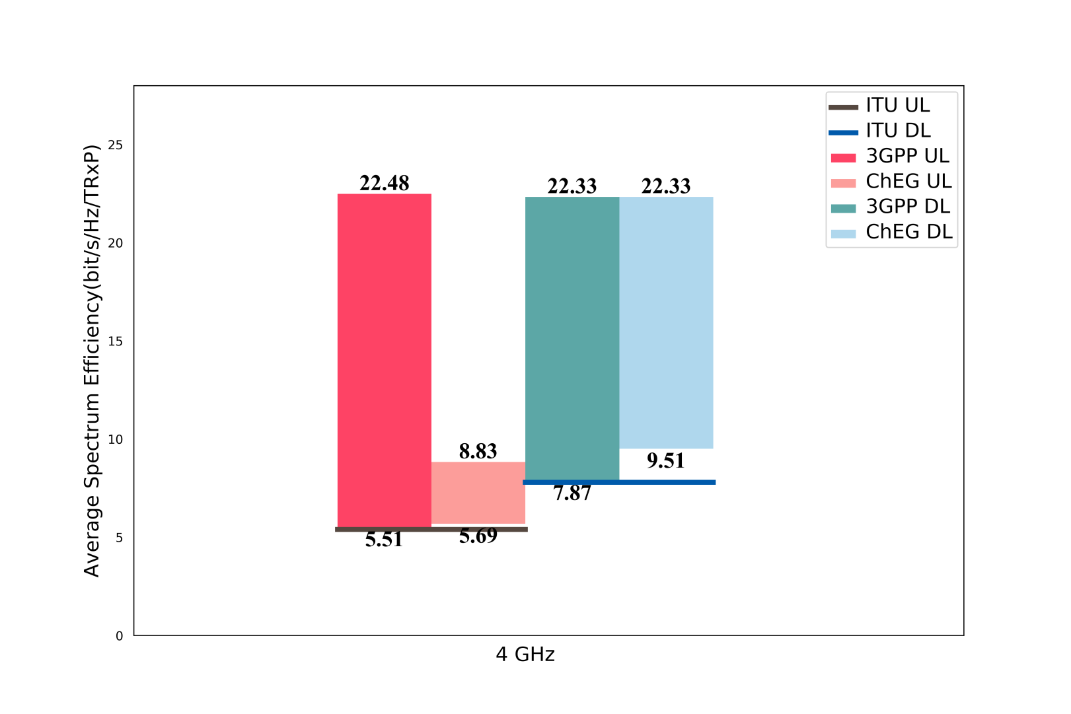
Preliminary results on Dense Urban-eMBB

Slide 17
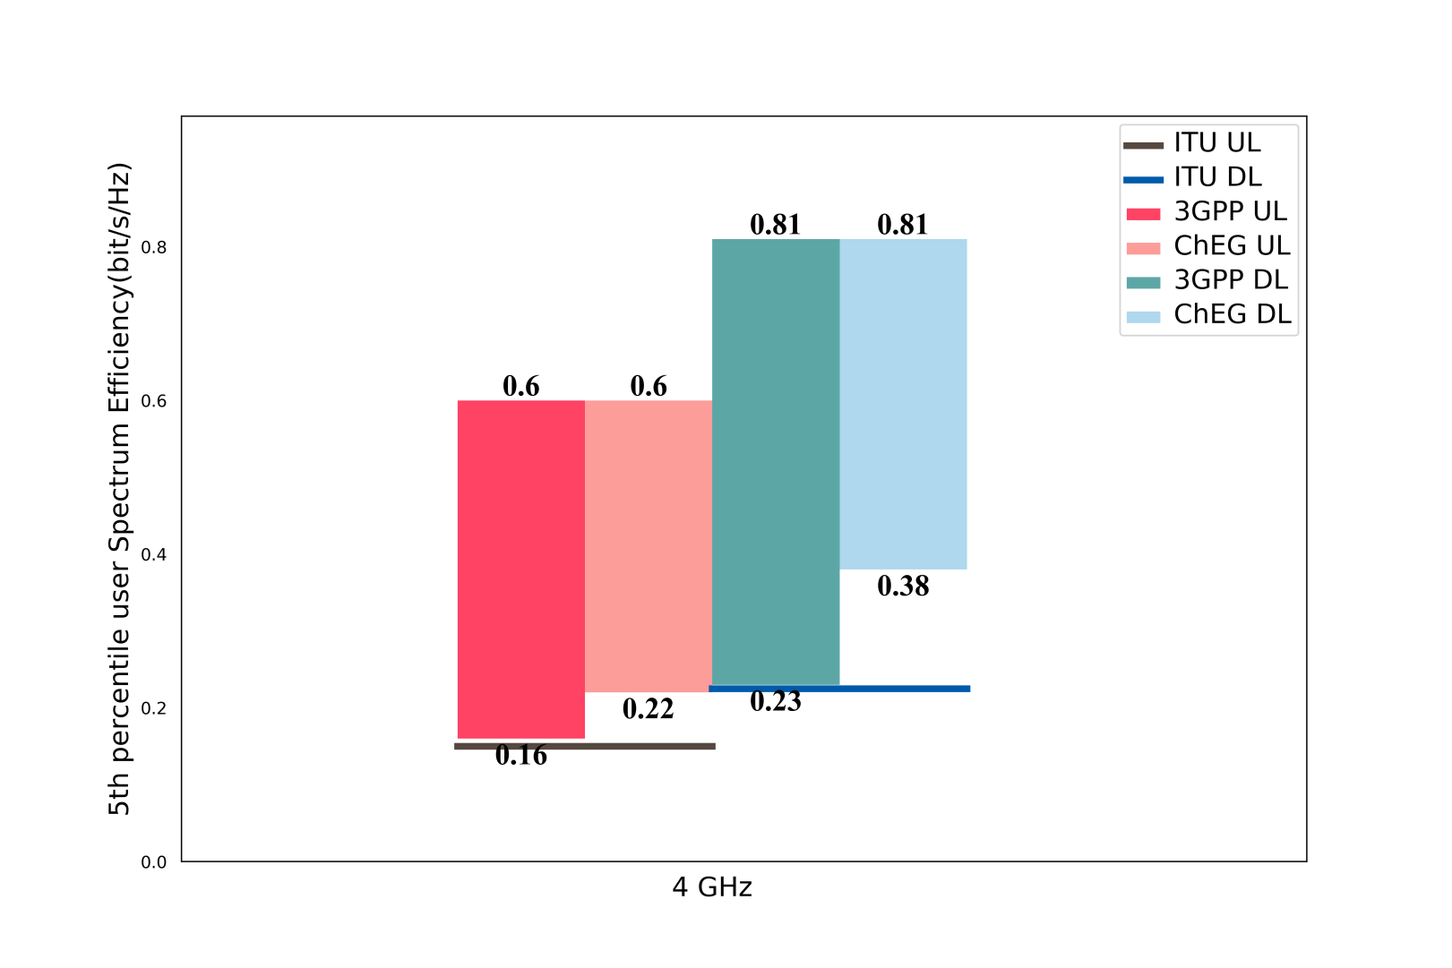
Preliminary results on Dense Urban-eMBB

Slide 18
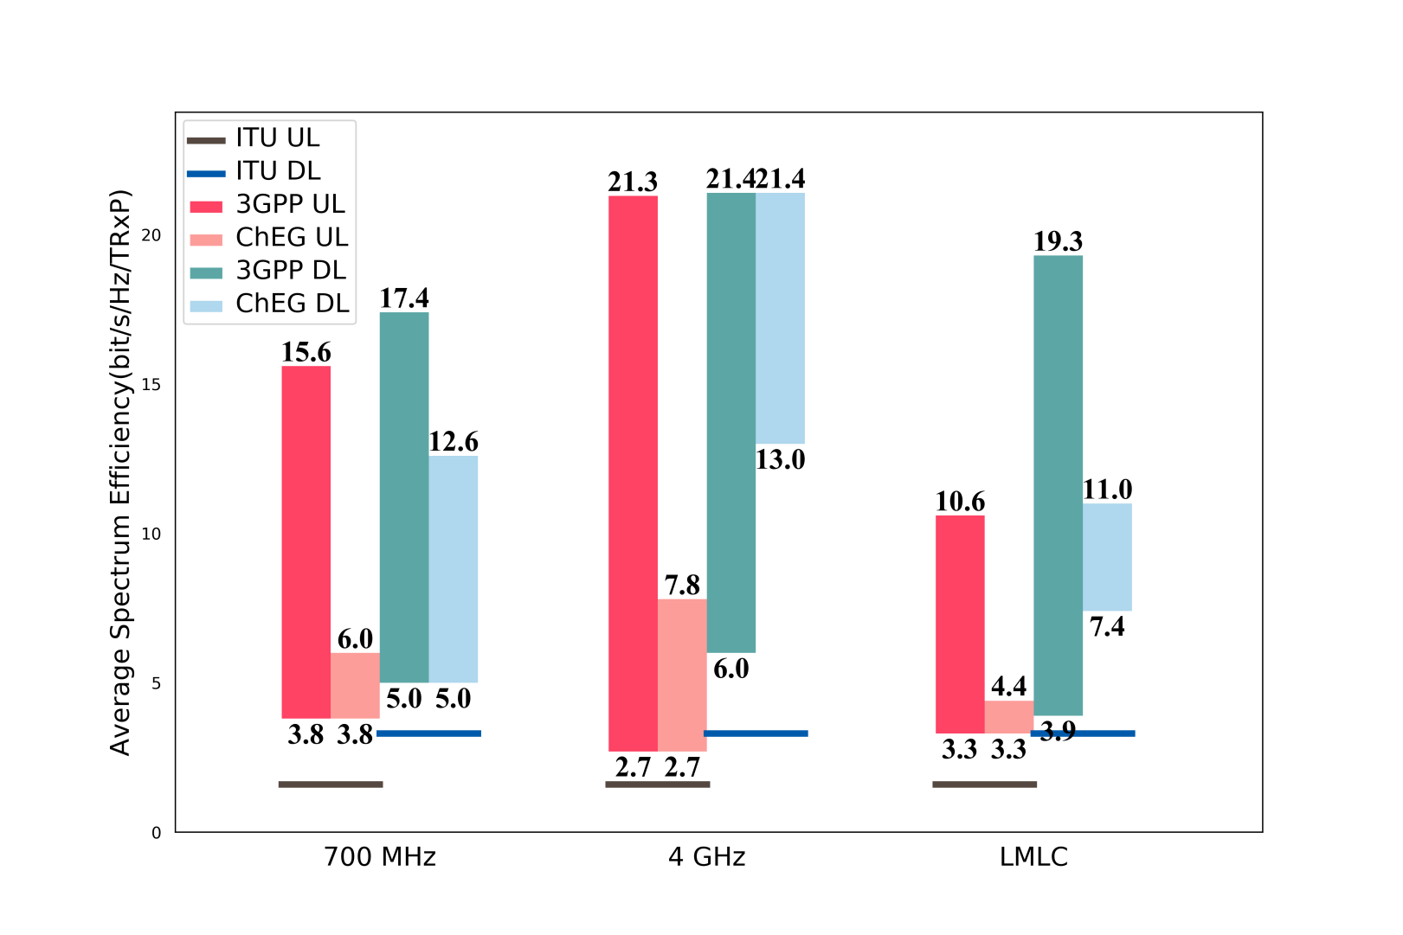
Preliminary results on Rural-eMBB

Slide 19
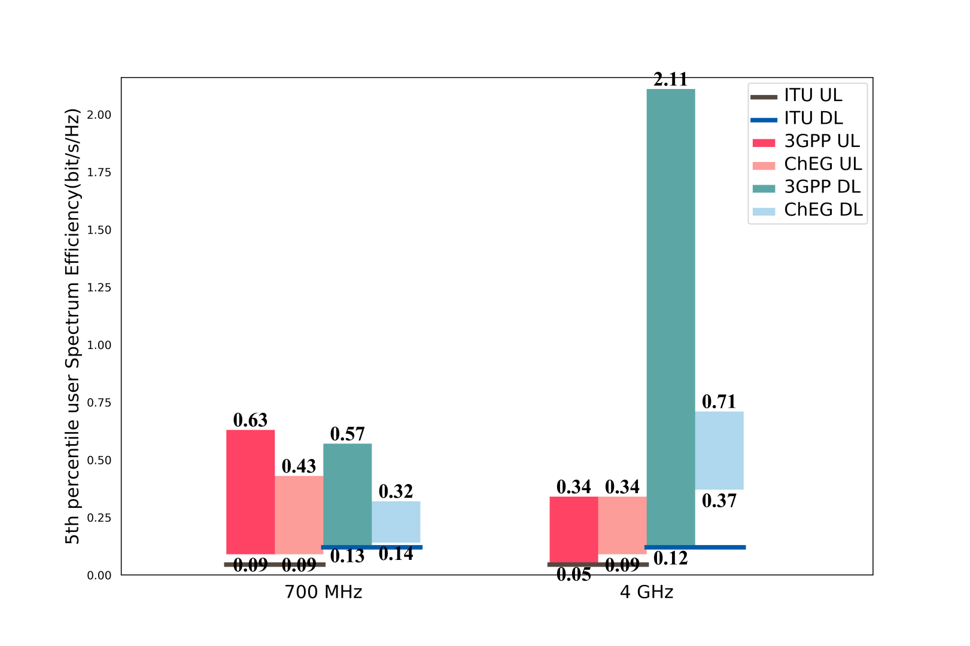
Preliminary results on Rural-eMBB

Slide 20
Preliminary results on Urban Macro-URLLC
Test Environment | Required value | Required value | Evaluation Configuration | 3GPP result | ChEG result
Urban Macro –URLLC | 1-10−5 success probability of transmitting a layer 2 PDU (protocol data unit) of size 32 bytes within 1 ms in channel quality of coverage edge | Downlink | Configuration A (4 GHz) | 99.99965%~99.99999% | 99.999899%~ 99.99991%
 |  |  | Configuration B (700 MHz) | 99.9994%~99. 9999991% | 99.9994%~ 99. 9998%
 |  | Uplink | Configuration A (4 GHz) | 99.9992%~99.9999999992% | 99.9992%~ 99.99999964%
 |  |  | Configuration B (700 MHz) | 99.9992%~99.99999999% | 99.9992%~ 99.99999999%

Slide 21
Preliminary results on Urban Macro-mMTC
 | System level simulation traffic model | Required value (device/km2) | Evaluation Configuration | 3GPP result | ChEG result
NB-IoT | full buffer | 1 000 000 | configuration A (ISD=500m) | 43,627,000/ 180 kHz~43,692,000/ 180 kHz | 41,325,000/ 180 kHz~41,981,000/ 180 kHz
 |  |  | configuration B (ISD=1732m) | 2,333,000/ 180 kHz~2,335,000/ 180 kHz | 2,384,315.5 / 180 kHz~2,447,084/ 180 kHz
 | non-full buffer |  | configuration A (ISD=500m) | 8,047,000/ 180 kHz~8,077,000/ 180 kHz | 8,047,087/180kHz~8,077,017/180kHz
 |  |  | configuration B (ISD=1732m) | 1,198,000 / 360kHz~1,203,880 / 360 kHz | 1,198,000/180kHz~1,203,880/180kHz
NR | full buffer | 1 000 000 | configuration A (ISD=500m) | 36,008,000/ 180 kHz~36,324,000/ 180 kHz | 36,901,760/180kHz~37,581,462/180kHz
 | non-full buffer |  | configuration B (ISD=1732m) | 1,267,000 / 180 kHz~1,503,000 / 180 kHz | 1,281,228/180kHz~1,444,728/180kHz

